Slide 1
Another Application of Filter Scanner Design- Solar Cell Calibration
C Stubbs, Oct 19, 2020
The foundational ‘metrology’ (measurement science) standard for our instrumental calibration approach is a Silicon photodiode whose quantum efficiency is known with a fractional uncertainty of less than a part per thousand.
Our goal is to transfer this knowledge to other systems and instruments.

Slide 2
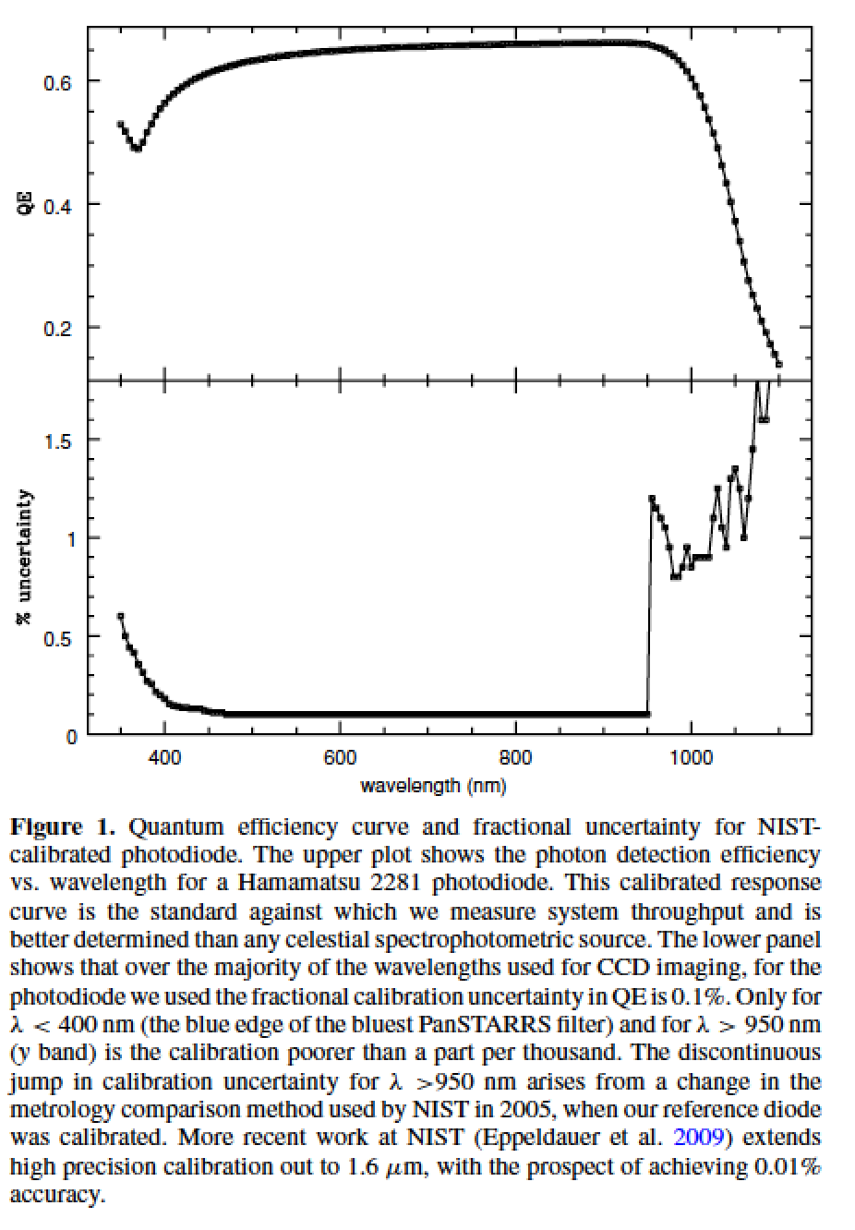
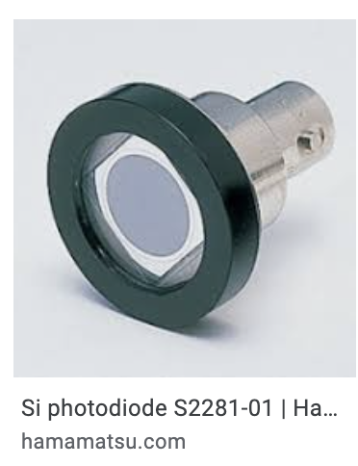
S2281 photodiode, manufactured by Hamamatsu and calibrated by NIST
1 cm diameter

Slide 3
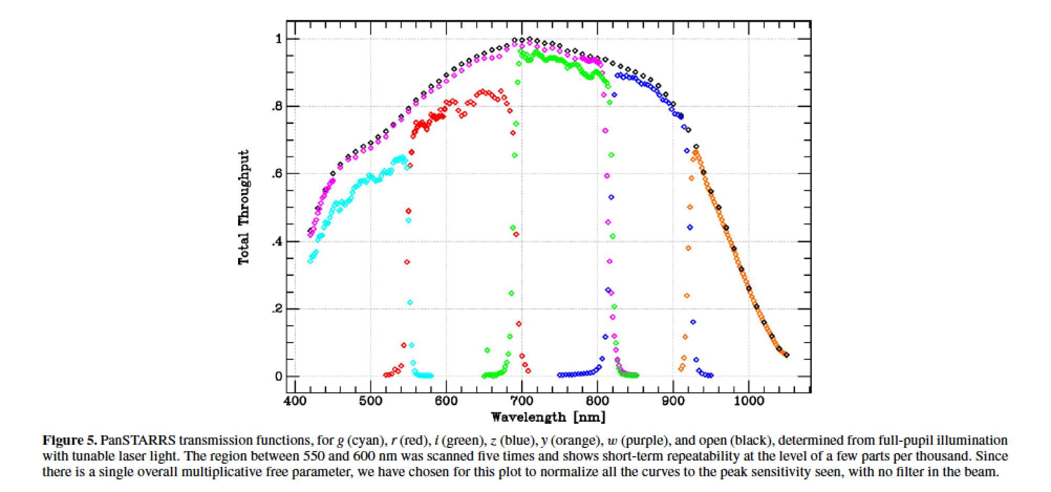
Conceptual plan:
Deliver known dose of photons to main telescope, and determine what fraction we detect.
Need to know this flux
Collimated
Beam
Projector
(CBP)
Telescope &
Instrument
Under test

Slide 4
Challenges-
We’d like to know how many photons are delivered to instrument under test
Photodiode is small compared to output beam size of collimated beam projector
Four options:
Use integrating sphere and measure intensity at focus
but before the output optics
We then need to measure transmission of
collimator separately. That’s been tough
2) Focus the CBP output beam down to 1 cm spot
can’t easily focus very close by. CBP focal length is 650mm
1/f=1/s+1/s’. Set s’=10m
set s=4 meters, then s’=776mm so focus moves 120mm=5 inches
refocusing changes the portions of the mirrors that light strikes = bad thing.
3) Sample a portion of the output beam with photodiode
assumes surface brightness of output is wavelength independent.
4) Do #3, but also use a much larger calibrated diode to capture and calibrate full output beam.

Slide 5
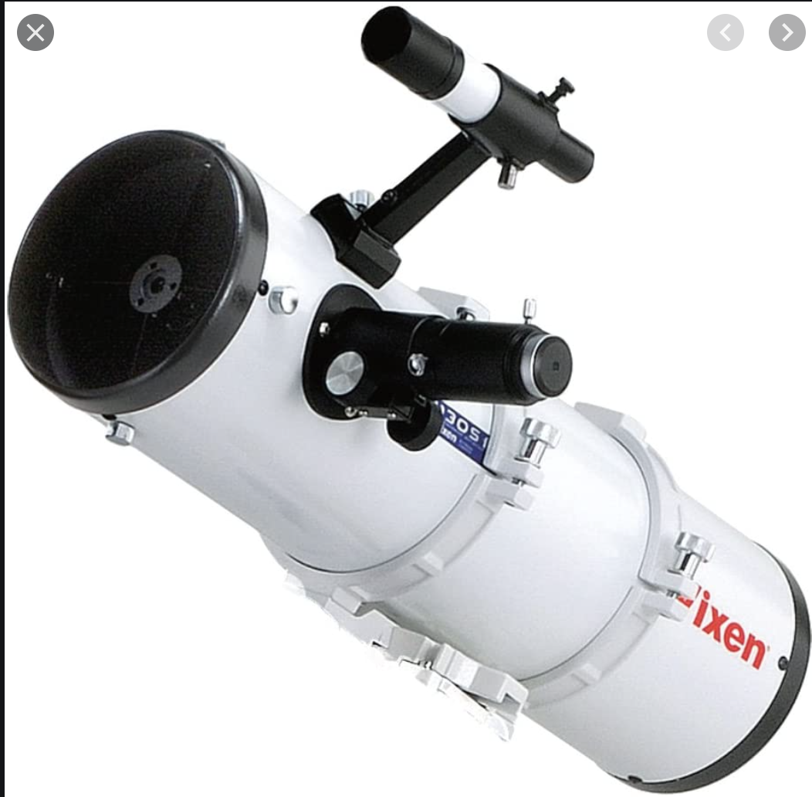
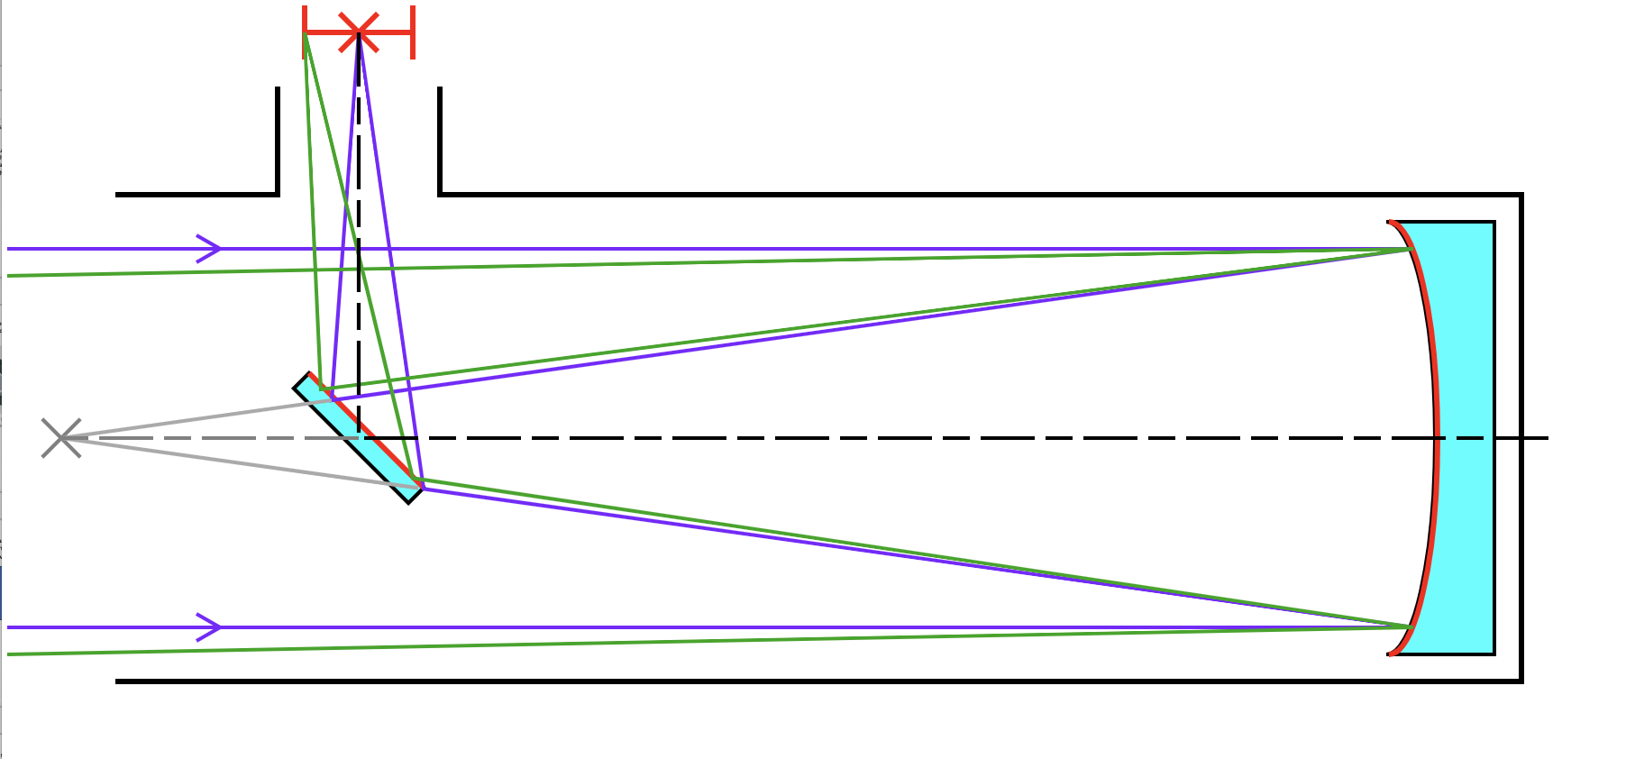
Next-gen CBP collimator- Vixen S130
Arcsecond resolution
130mm mirror diameter
Secondary mirror obscures the beam
Few-arcminute field of view before off-axis aberrations degrade PSF
We seek a diode ~120mm in diameter to capture full output beam

Slide 6
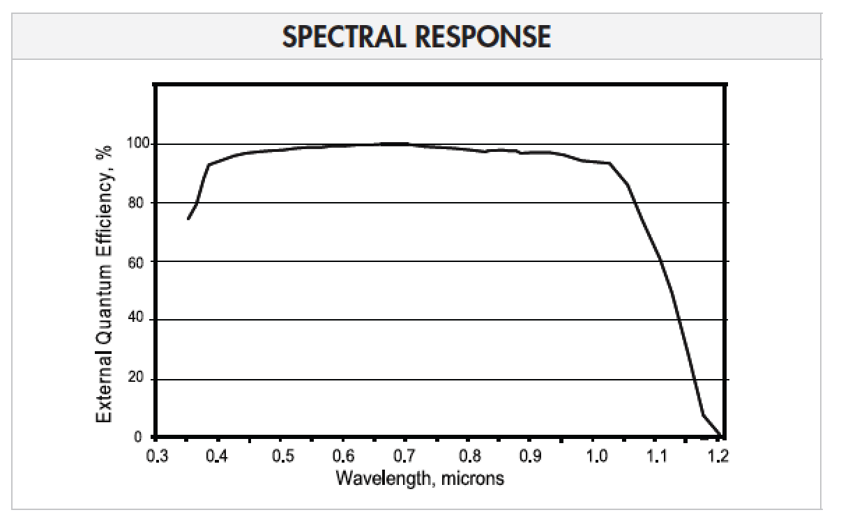
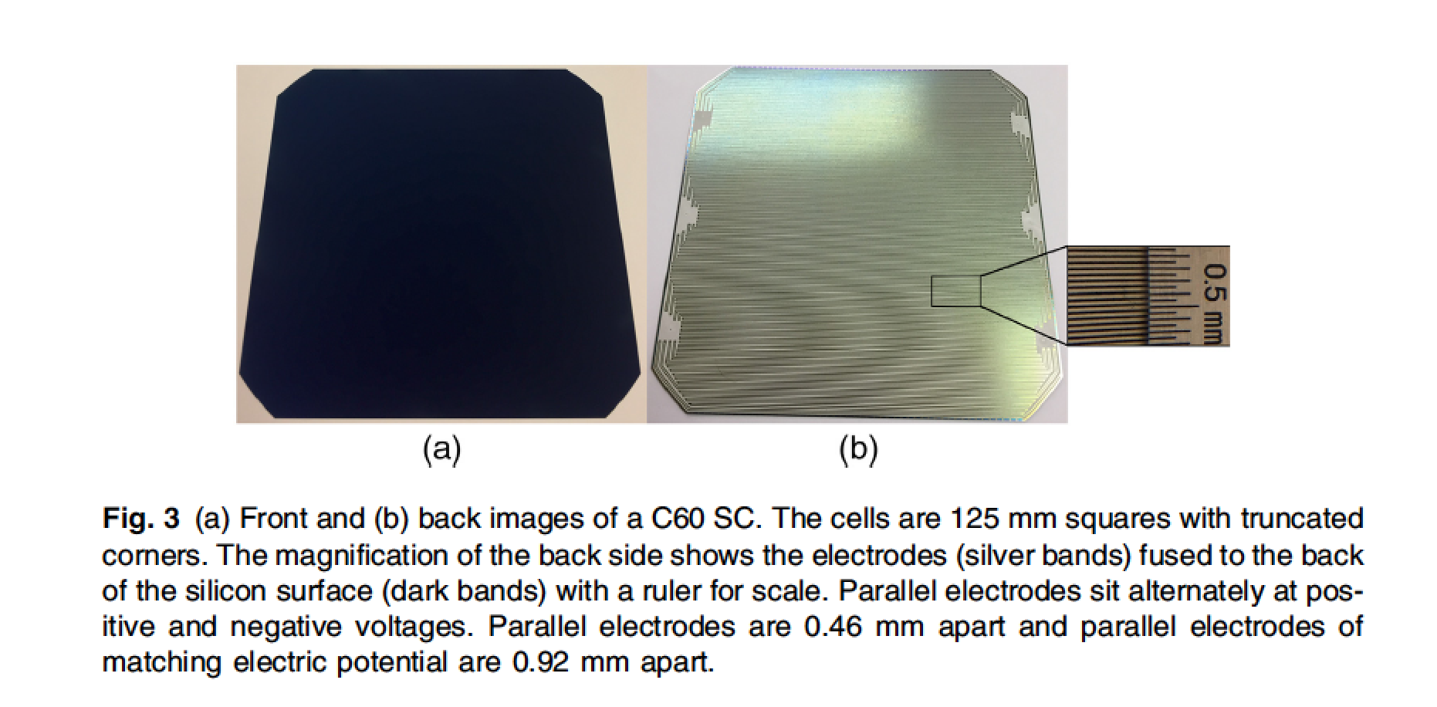
Maxeon C60 solar cell
125 x 125 mm in size

Slide 7
Need to transfer QE knowledge from NIST photodiode to solar cell
Conceptual design of filter scanner is great for this!

Slide 8
More-detailed version
Mirror 1 Mirror 2
photodiode, stability monitor
Chopper wheel
Modulated light
50-50
beamsplitter
Optical fiber,
diameter D~100 microns
NIST diode on translation stage
Spot size is
(FL2/FL1)*D
Monochromator to give single wavelength
Solar cell

Slide 9
Solar cell
Stability monitor
To telescope
To full-aperture calibrator

